Slide 1
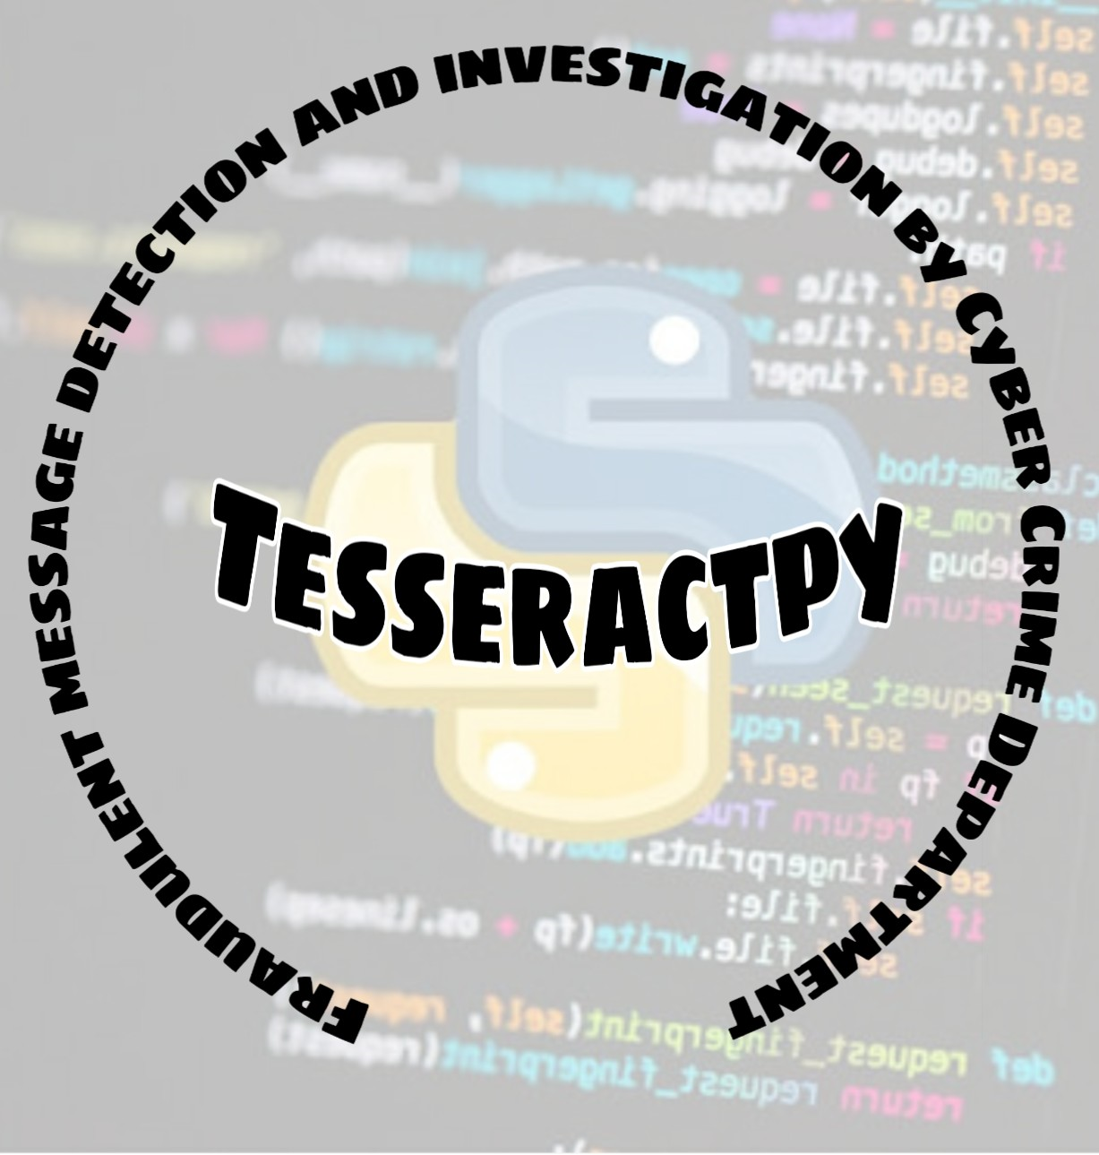

Slide 2
Problem Statements: (Source: Smart India Hackathon 2020 KB186)
Solutions required to solve the challenges faced by Law Investigating Officers (LEOs) in Cyber Crimes:
1) Mechanism / tool that retrieves the information relating to transmission of a disputed posting and immediate deletion of the same within no time from WhatsApp messenger.
2) Mechanism / tool that capture the GPS coordinates & other credentials of certain message / posting posted using WhatsApp / Facebook and other messaging APPs.
3) Mechanism / tool that retrieves the initial user of certain posting in WhatsApp and Facebook using message ID.
4) Mechanism / tool that pings any social media account and capture the IP address and other credentials associated with that account.
5) Mechanism / tool / device that sends a signal to the target mobile and calculate the distance and direction from the source.

Slide 3

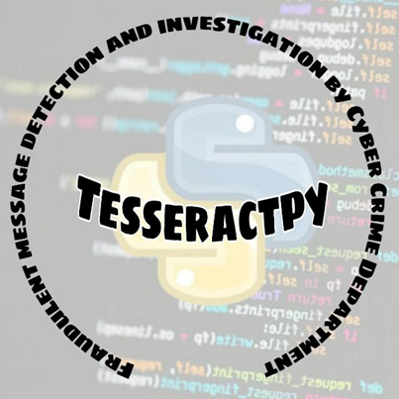
Social Media:
Connects people
Medium of Sharing information
user-generated content(UGC)
promotes professional/personal commerce

Slide 4

But What if Social Media became a victim for Disputing And Misleading content Source
Triggering Riots in Nation
Social Media Rumours
Disputing posts
Spreading Fake news

Slide 5



Disputes took placed because of the Existing problems on social media:

Slide 6
Proposed Idea and Architecture

Slide 7
Social Media App
GPS Access Primary Requirement
Admin Panel
User Interface
Reported Messages
Blocked Messages
Capture IP & GPS Coordinates
Sender & Initial Sender
Sender Side
Message
Sentiment Analysis + Keyword Matching
IP & Credential
Location Tracking
Disputed
Non-Disputed
After Certain Count
Keyword is added
Message Blocked
Positive
Negative
Keyword Extraction
Message sent to Receiver

Slide 8




Technologies Being Used:
Android
Tensorflow Lite
Python
Firebase Database
Firebase Authentication

Slide 9


Challenges Faced
Data protection
End-to-End Encryption
User’s Privacy

Slide 10
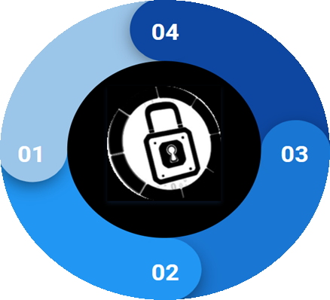
How we Overcome those Difficulties
TF Lite Model
No Message Content is shared with External server
Predictions made
Locally
End-to-End privacy is
maintained

Slide 11
Advantages
Requires very less space
Gives Faster Result
Predictions are made locally
User’s privacy is protected
End-to-End Encryption is maintained
Can be implemented in any type of Social Media App
Can be used in production without any reluctance
Model Size | Device | CPU
0.6Mb | Pixel 3 (Android 10) | 0.05ms*
 | Pixel 4 (Android 10) | 0.05ms*
 | iPhone XS (iSO 12.4.1) | 0.025ms**
Source: https://www.tensorflow.org/lite/models/text_classification/overview

Slide 12
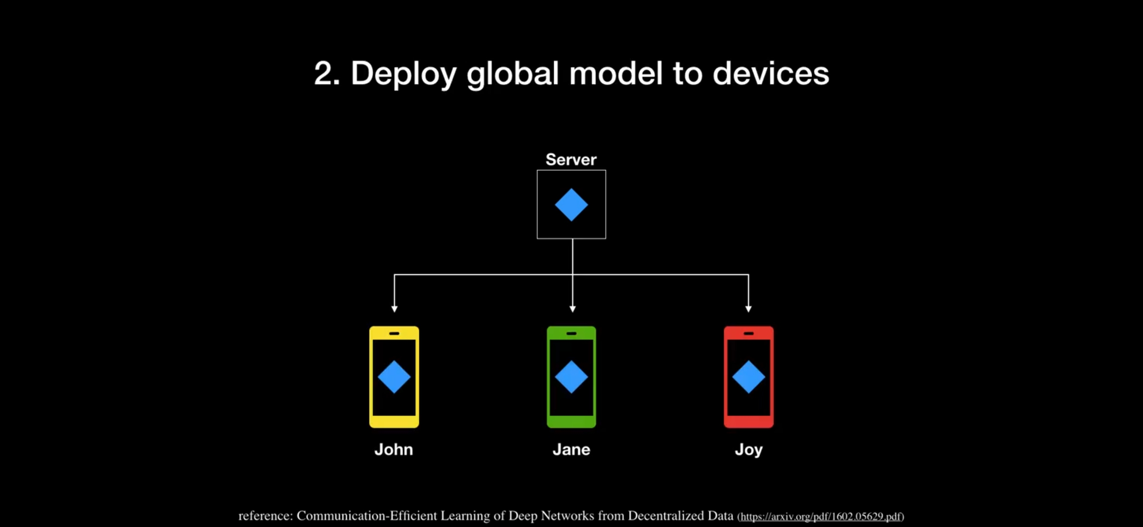
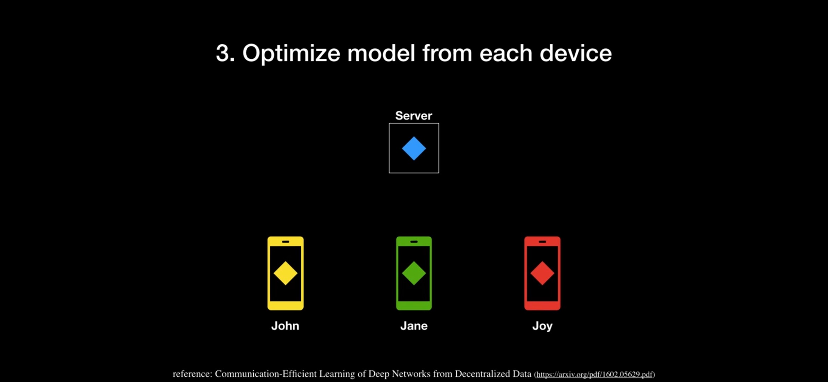
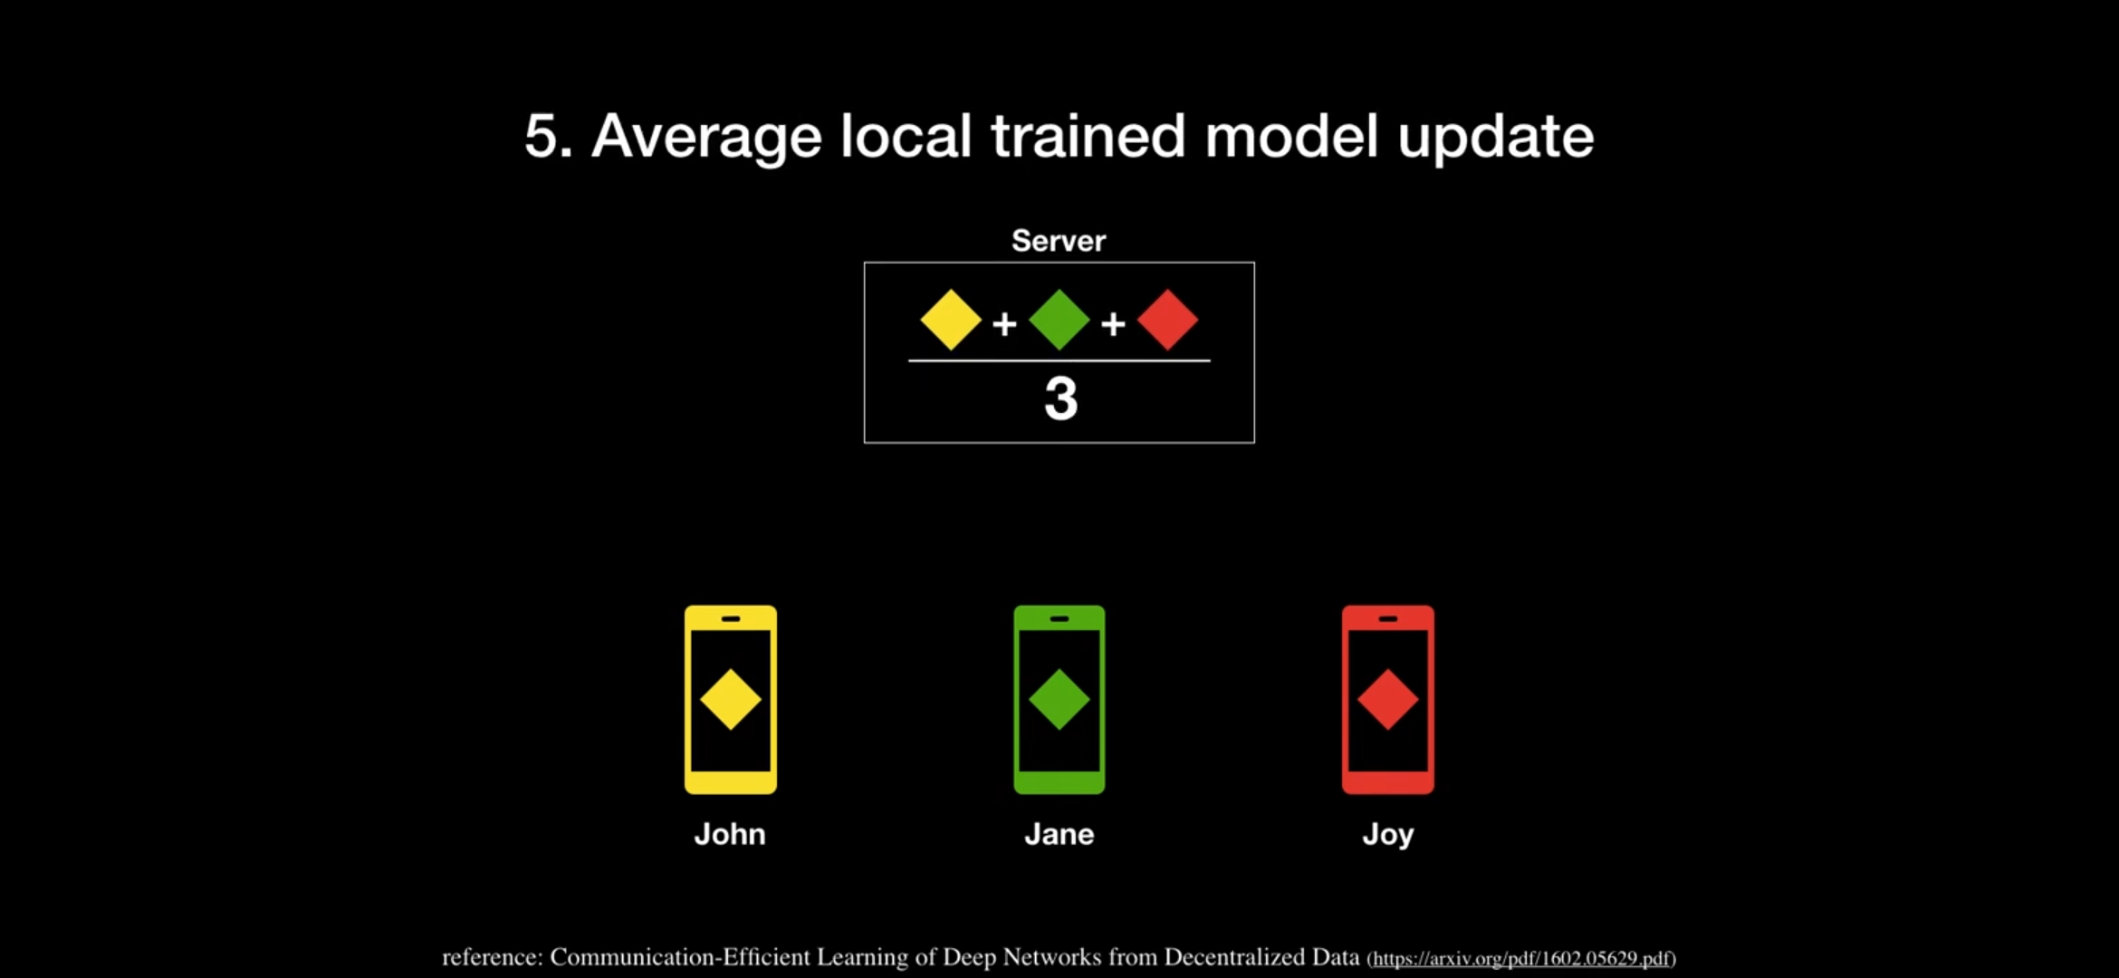
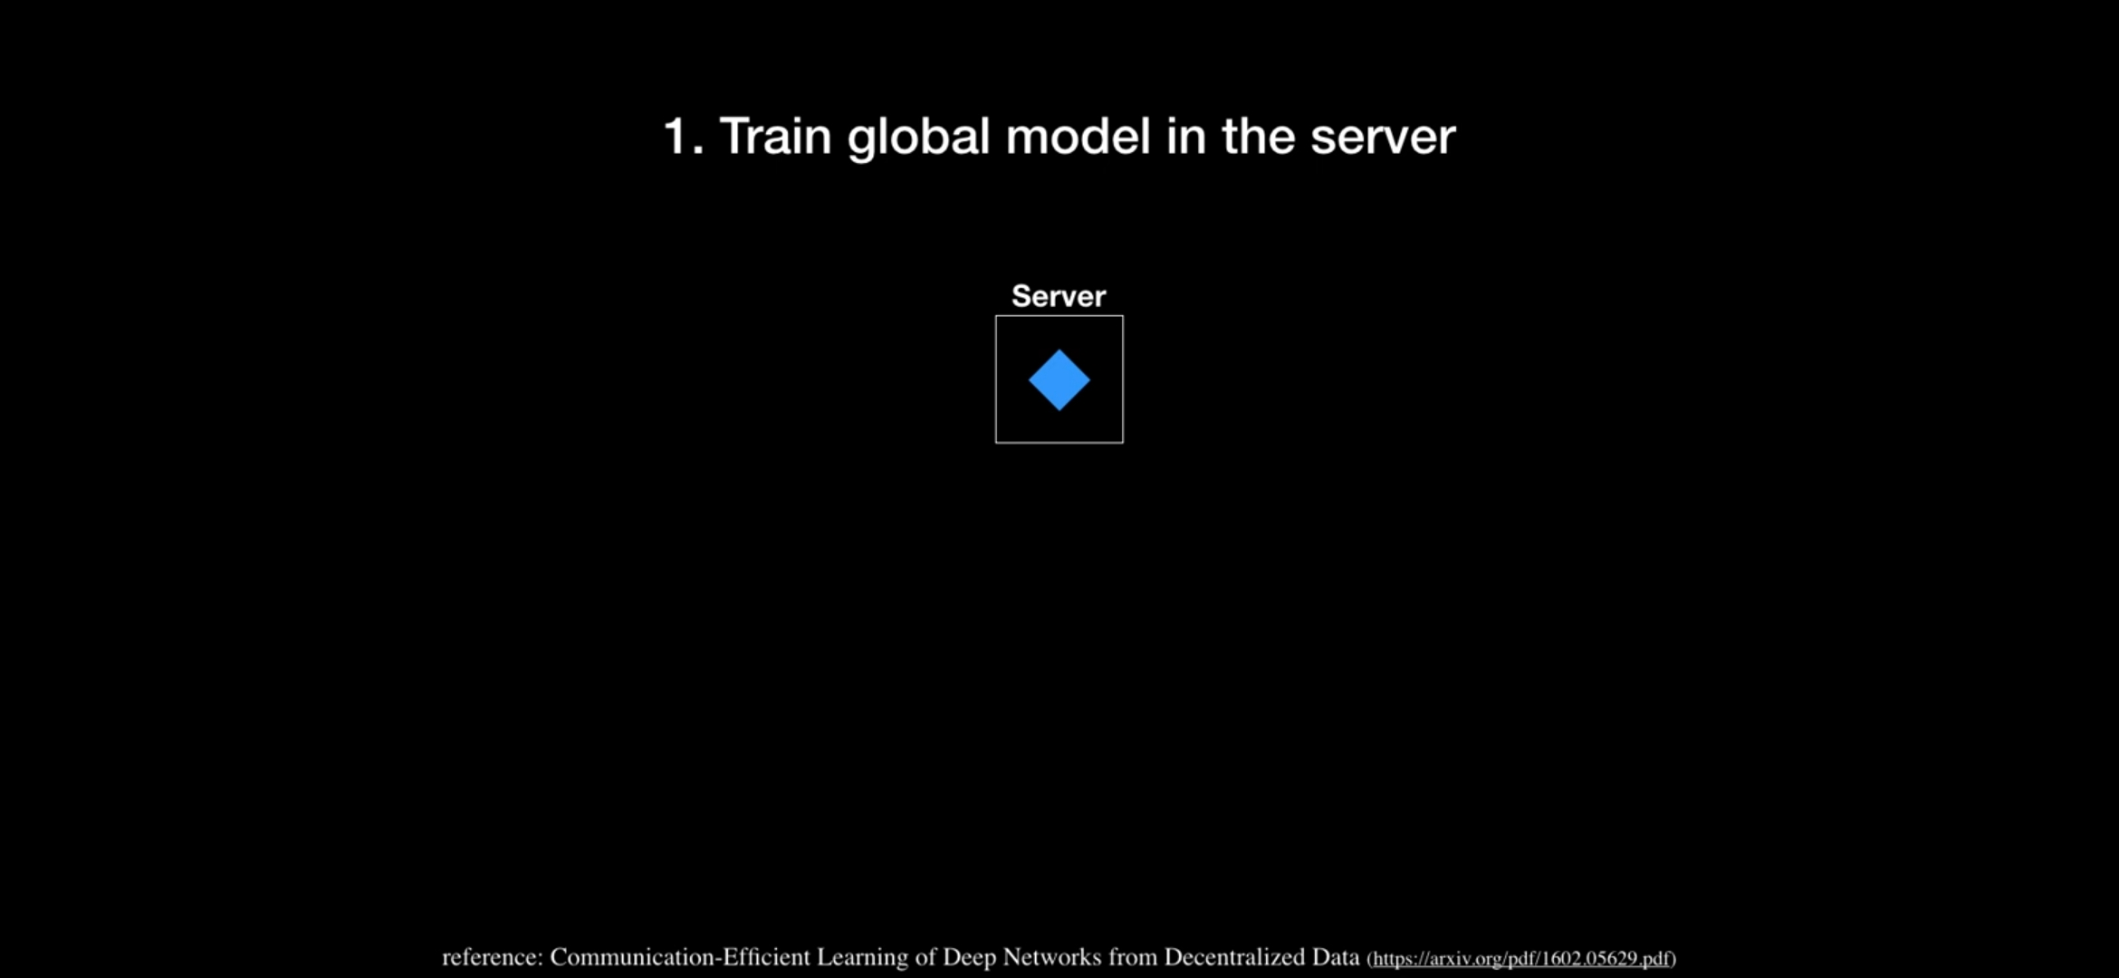
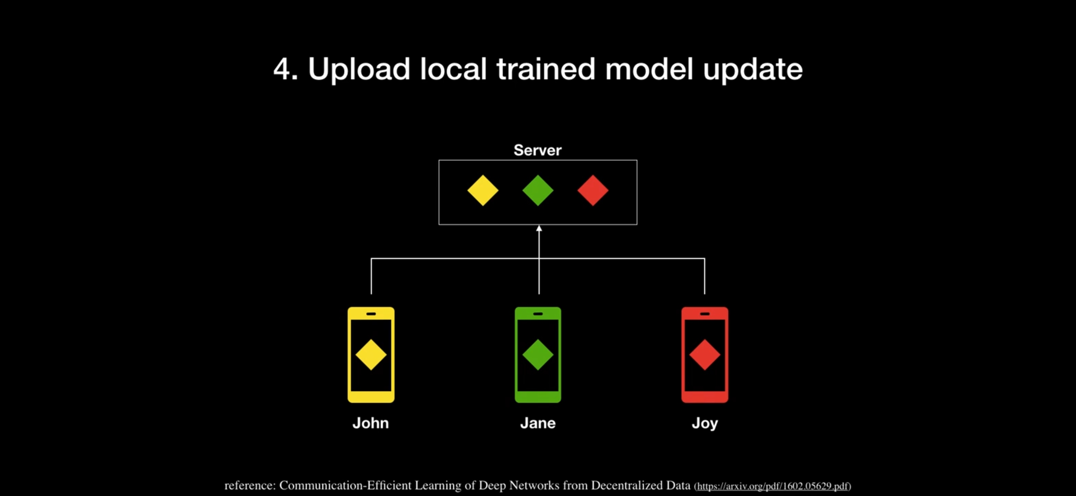
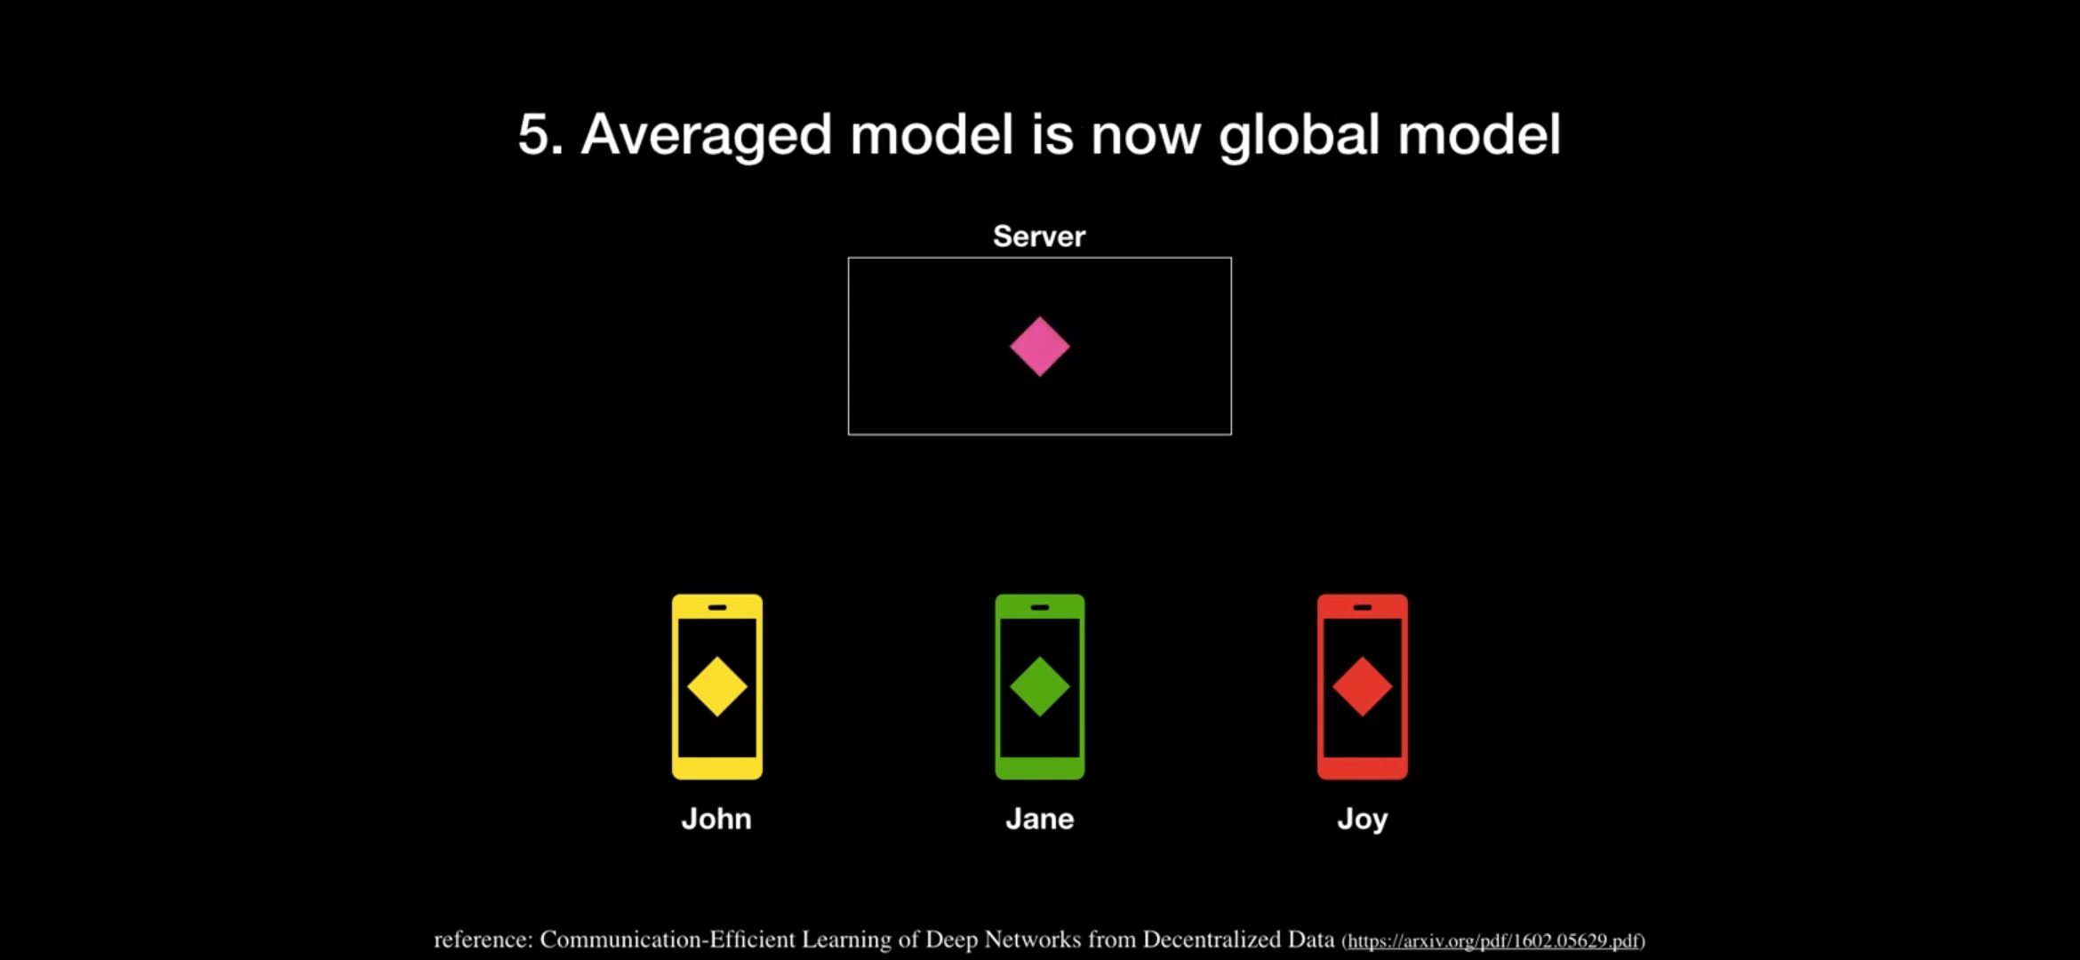
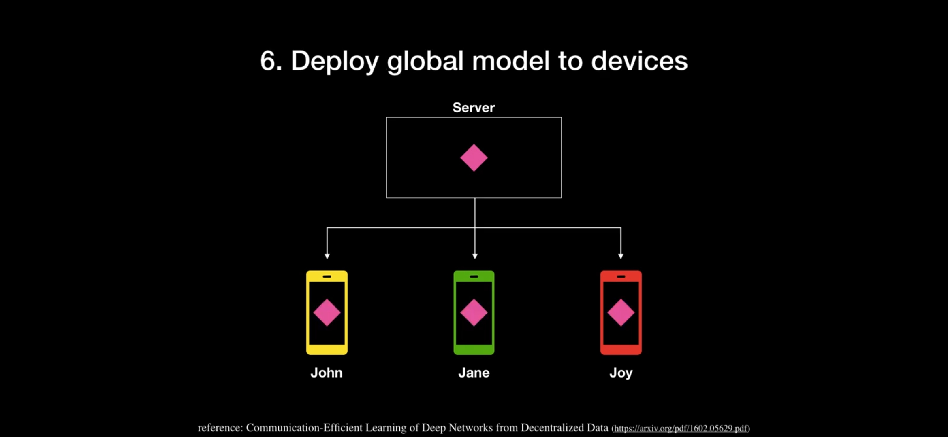
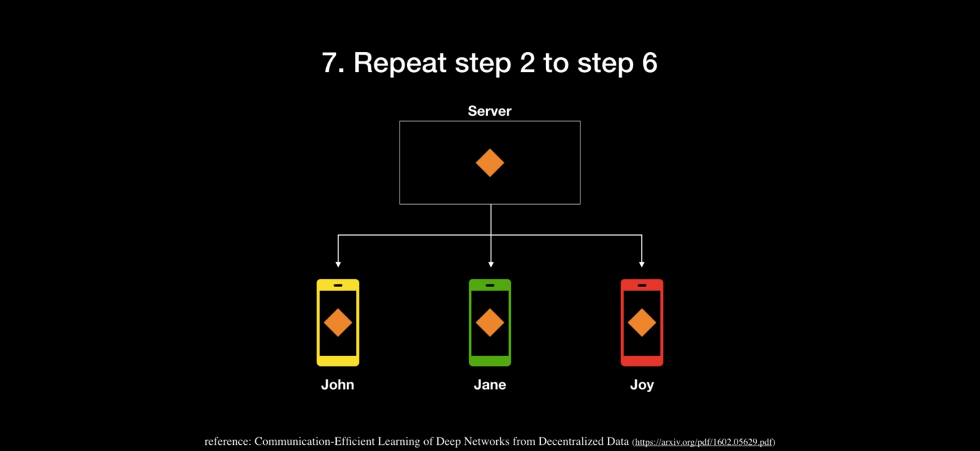
Future Scopes:
Federated learning can be applied
Multi-language BERT Model

Slide 13


